Slide 1
Estrogens As a Form of Slow Violence

Slide 2
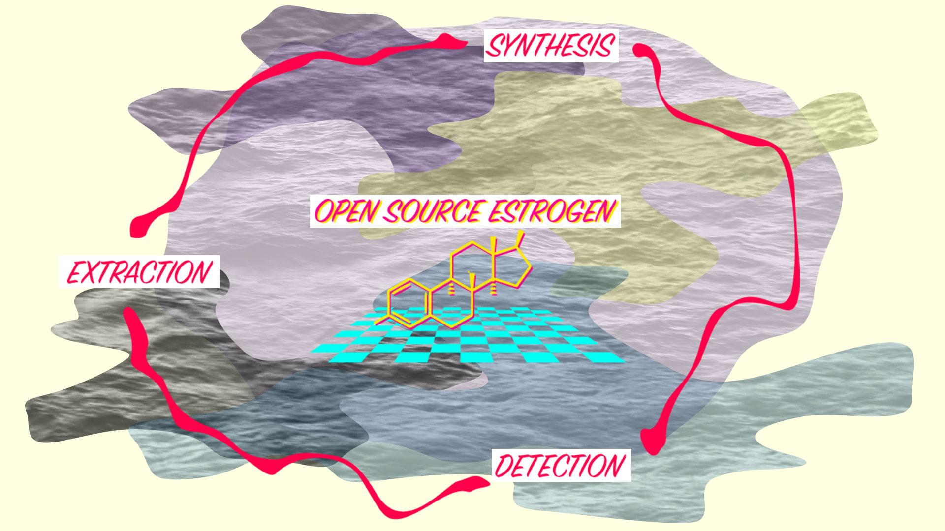
Introduction
What Is Slow Violence?
How to use it in Open Source Estrogen
Project

Slide 3
Theoretical Source

Slide 4
Slow Violence
Slow Violence: Violence that occurs gradually and out of sight.
It is not a spectacular and instantaneous violence but a kind of violence that is tipically not viewed as violence.
It is related to indirect or structural violence.
Estrogen contamination can be viewed as this kind of violence.

Slide 5
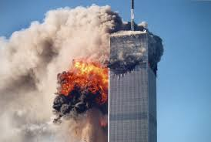
Media Treatment of Violence
Media Treatment of Violence is
focused on spectacle

Slide 6
Slow Violence and Media Treatment
Slow violence calamities, as estrogen contamination, use to be unattended by media.
How to turn emergencies of slow violence into dramatic stories to involve civil society and warrant political intervention?
We need creative ways of drawing public attention to acts of violence which are low in instant spectacle.

Slide 7
Some Ideas
Changing our perception of time processes
Taking profit of contemporary technologies

Slide 8
Rob Nixon’s Quotation
“writers, filmmakers, and digital activists may play a mediating role in helping counter the layered invisibility that results from insidious threats, from temporal protractedness, and from the fact that the afflicted are people whose quality of life—and often whose very existence—is of indifferent interest to the corporate media” (16)

Slide 9
How?
Through the idea of Apprehension.
Apprehension draws perception, emotion and action

Slide 11
Open Discussion
Perception Detection
Emotion Extraction
Action Synthesis

Slide 12
Conclusions

